Slide 1
Data Science Roles and their Salaries around the world
Presented by Carl Gonzales, Prathima Polavarapu, Shang Xu

Slide 2
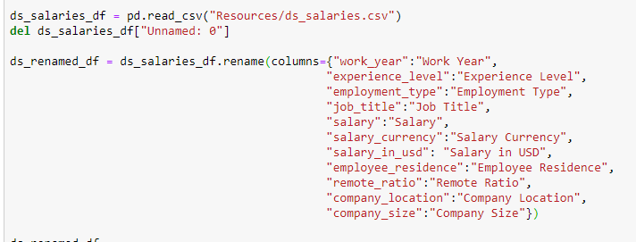
Data exploration and clean up process
Notes:
So to briefly explain the clean up process.
So we started off by obviously reading in the csv file.
For the most part, the data was quite clean already.
There was a blank first column that we wanted to remove so we just used the delete function for that.
And since the csv file had ugly column titles we wanted to rename them so they were legible enough to understand.

Slide 3
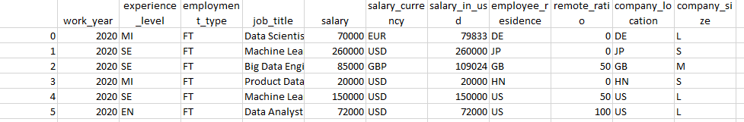
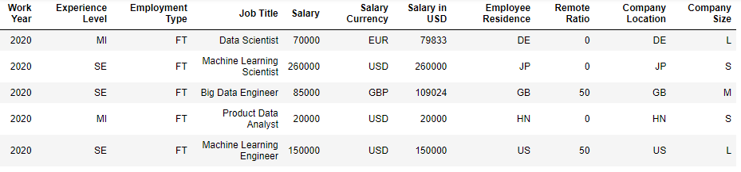
Notes:
So at the top is the original csv file that we want to read into Jupyter and clean up.
And at the bottom is what our dataframe looked like after the clean up.

Slide 4
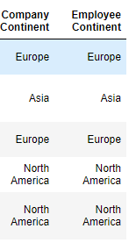
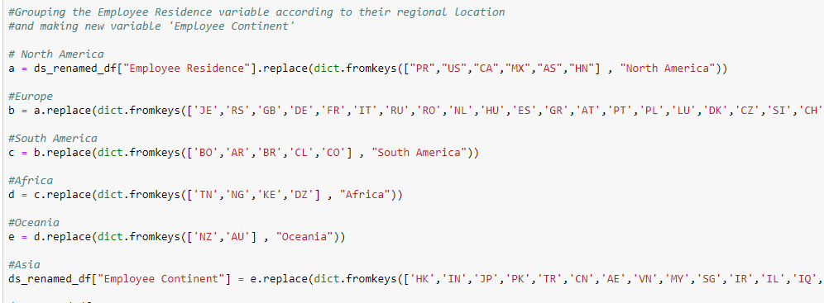
Grouping the countries into continents
Notes:
Additionally to our data frame, we had noticed that the Employee Residence and Company Location columns contained a large amount of different country values (around 50+). So we wanted to narrow it down by grouping the countries into their continents.
We did this by creating dictionaries for each continent and using the current Employee Residence and Company Location columns to create 2 new columns titled Employee Continent and Company Continent.
Now looking at that snippet, you’re probably wondering why we did it for both columns, and its simply because some employees reported working for companies that were located in a continent different from where they live.
These columns were needed to conduct Prathima’s research question which she will talk about later.

Slide 5
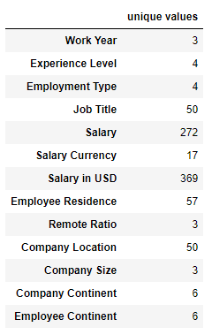
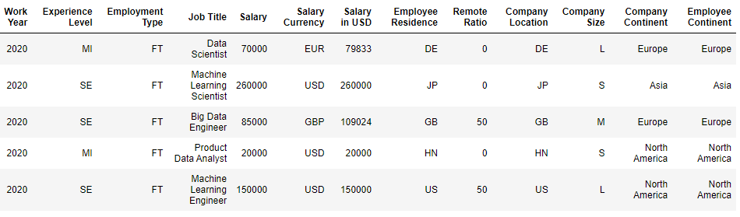
Final cleaned up data frame
Notes:
And heres a snippet of the final cleaned dataframe that we have used for our project.
As well as a table of the number of unique values for each column in our data frame.

Slide 6
Research Question 1:
Is there a difference in salaries between those employees working from home and those employees working from the office?
How do data science role salaries vary by employee experience level?
Notes:
Read research question –
In today's society, due to data science roles being predominantly online in nature, it is possible for individuals to complete their work duties from whatever location as long as they have access to their desktop/laptop.
Initial feeling would be that employees will take up a cut in their salary to gain the benefit of working from home.

Slide 7
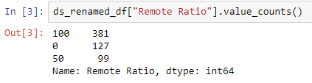
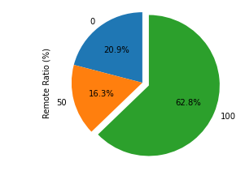
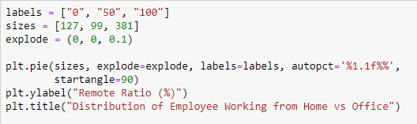
The distribution of employees working from home vs. office
Notes:
So to start off, I wanted to find out the distribution of values of employees working from home vs the office.
We ran the value count code to find that shows that employees in the survey predominantly work from home (381 out of 607) which is more than half the sample.
Then I ran the code to create a pie chart to better visualise the data. So you can definitely see that most employees in a data science role have the benefit of working from home. And there are a small amount of employees who either do not have the benefit or simply feel its better to work in the office.

Slide 8
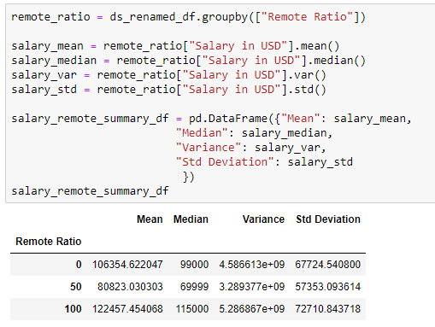
Summary statistics table – remote ratio vs salary
Notes:
So to create the summary statistics table, I used the groupby function to calculate the mean, median, variance and standard dev for remote ratio.
According to the summary statistics table, employees completely working from home earn the most (mean of 122,457), followed by those who completely work from the office (mean of 106,354). Interestingly enough, those who do both earn the least on average (mean of 80,823). So my initial prediction of people working from the office earning more was completely wrong and its actually the opposite in that regard.

Slide 9
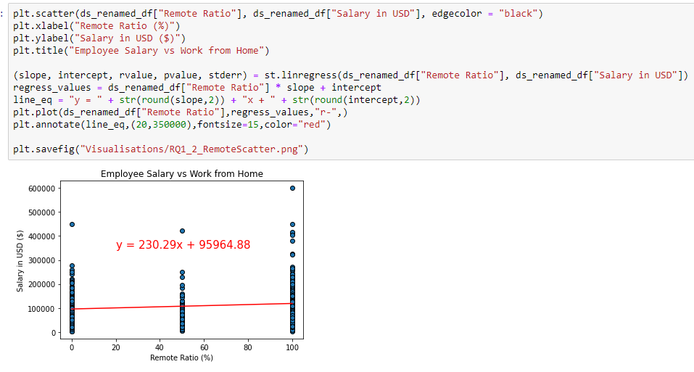
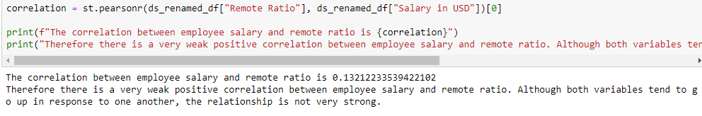
Bar chart: employee salary vs work from home
Notes:
Additionally, I created a bar chart with a linear regression line to further prove that working from home or the office has no significant effect on how much salary an employee earns.
I decided to use correlation coefficient as the measure, because I was using 2 numerical variables in Salary and Remote Ratio. Arguably, I could’ve used a different measure because you could also say that remote ratio is categorical because of the fact that there were only 3 options (work from home, work in the office, or both).
According to our bar graph, we have calculated a correlation coefficient of 0.13. There is a small visible slope on the graph and therefore there is a very weak positive correlation between employee salary and remote ratio. Although both variables tend to go up in response to one another, the relationship is not very strong.
So I can for sure conclude that, it doesn’t really matter where the employee works as it as salary is not very dependent on it.

Slide 10
So is employee salary dependent on something else?

Slide 11
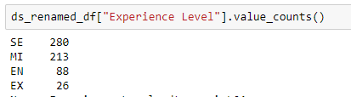
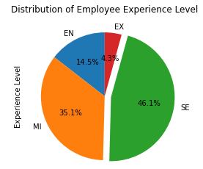
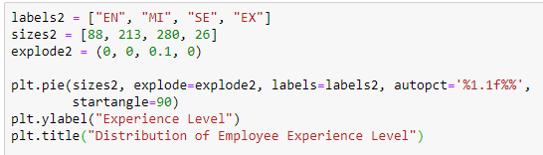
The distribution of employee experience level
Notes:
So similarly to the previous question, I wanted to find out the distribution of values of experience level of employees
I ran the value count function to find that shows that employees in the survey predominantly are senior and mid level (which take up around 81% of total sample)
Then I ran the code to create a pie chart to better visualise the data.

Slide 12
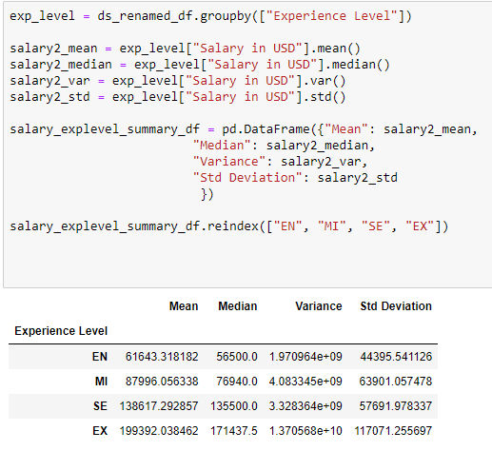
Summary statistics table - experience level vs salary
Notes:
So same thing, I used the groupby function to find the mean, median , variance and std dev for experience level.
It is clear that the average salary increases significantly as an employee progresses from entry level (61,643 USD) all the way to executive level (199,392 USD).

Slide 13
Hypothesis testing – employee salary vs experience level
Null Hypothesis
An employee's experience level has NO EFFECT on their salary.
Alternative Hypothesis
An employee's experience level will result in an improvement on their salary.
Notes:
Furthermore to prove experience level has a positive effect on salary, I did some hypothesis testing for this next question.
Since salary is a numerical variable and experience level is a categorical variable, the most relevant test we can use is ANOVA.
The null hypothesis is 'An employee's experience level has NO EFFECT on their salary.
The alternative hypothesis is 'An employee's experience level will result in an improvement on their salary.

Slide 14

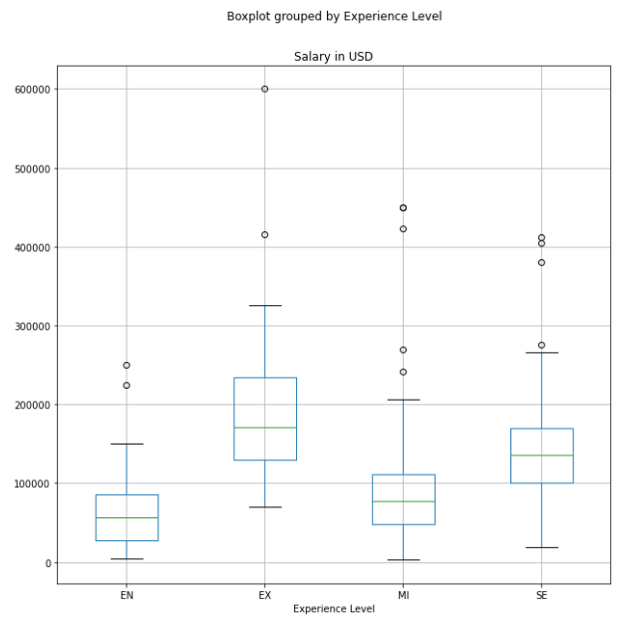
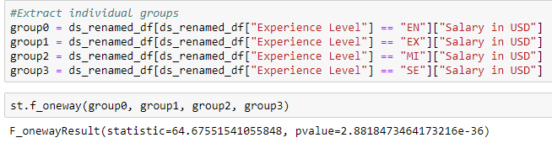
Box plot: employee salary vs experience level
Notes:
I feel like creating the box plot was the most appropriate for this test and when comparing these 2 variables.
As you can see it points out the various salary outliers for each experience level and
Also most importantly we can see the median salary for each shown by the green line. The fact the median lines are not similar, ensures that we can adopt our alternative hypothesis of ‘An employee's experience level will result in an improvement on their salary.’
As for the ANOVA test, I extracted the individual groups to get the f-statistic and p-value calculations.
Since the F-stat value is quite large (64), it is more likely that the variation associated with experience level is real and not due to chance.
Our p-value (2.88x10^-36) is significantly less than 0.05. We can say that we have sufficient evidence that allows us to reject our null hypothesis and conclude that an employee's experience level has an extremely significant effect on their salary.

Slide 15

How do data science Salaries vary by geographic Locations?
prathima

Slide 16
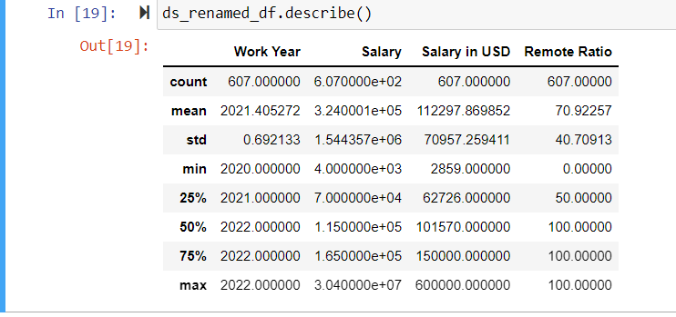
Read & clean data as requirements.
Describe data (Mean , Median and SD data)

Slide 17
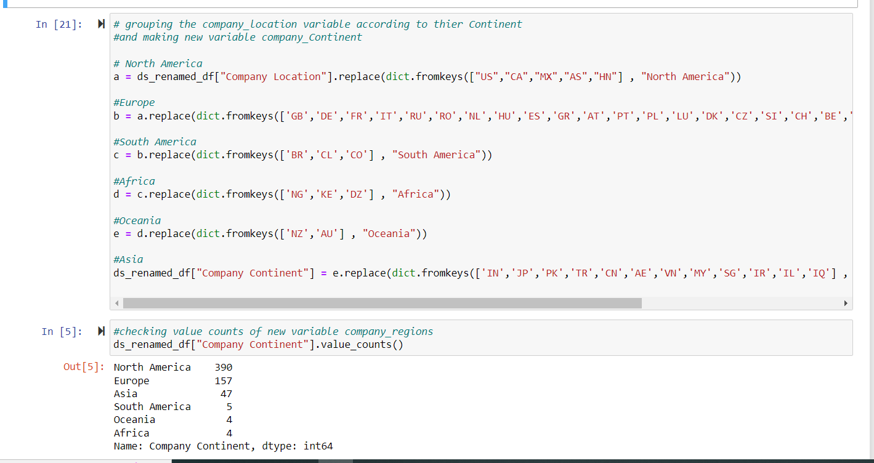
Grouping Company Location, Employee Location to their Continent.

Slide 18
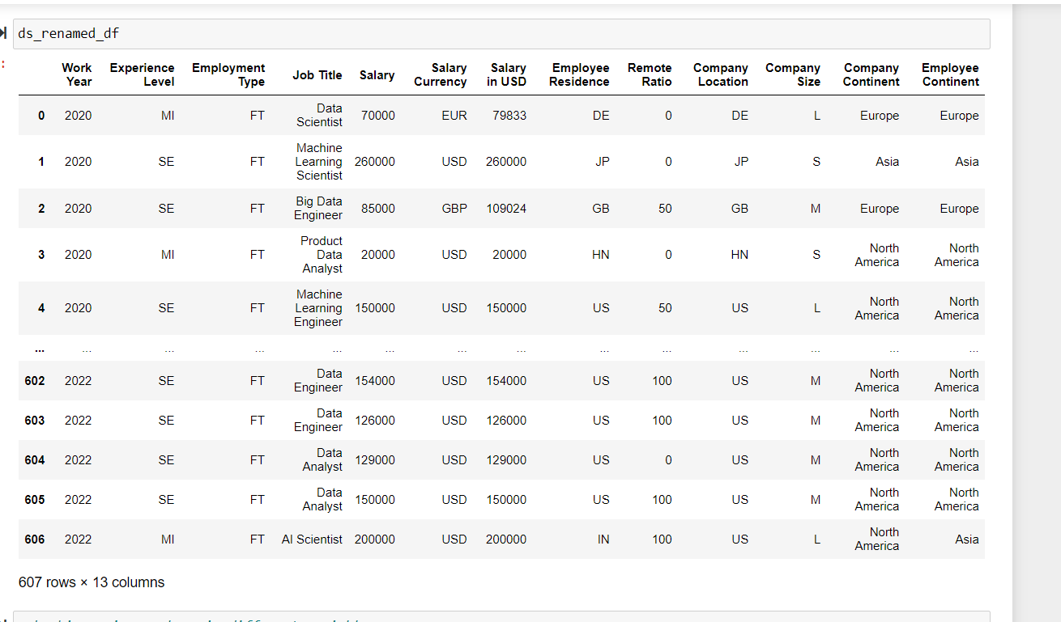
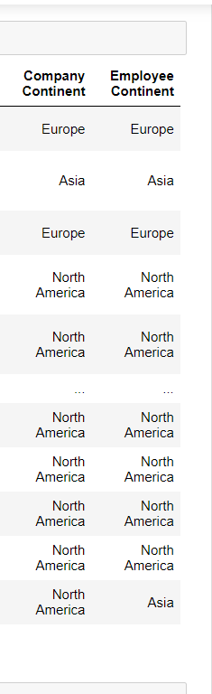
Added 2 Columns into Data Frame

Slide 19
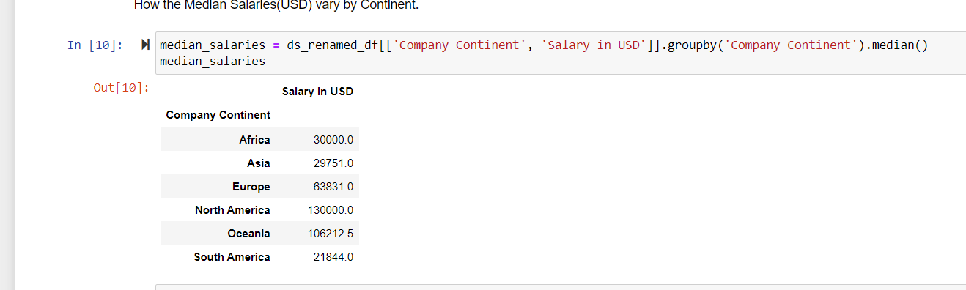
Exploratory Data Analysis 📊

Slide 20
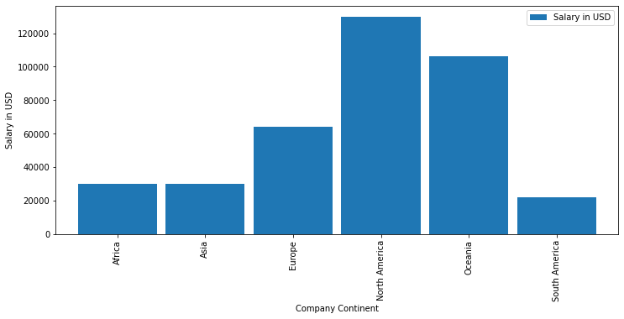
* Observation: In this Graph Shows Highest to lowest Salaries in Continent. North America , Oceania, Europe, Africa, Asia and South America.

Slide 21
API’s & JSON

Slide 22
API’S and JSON
*I Used Median Salaries(USD) Add Data Science company continent to Map.

Slide 23
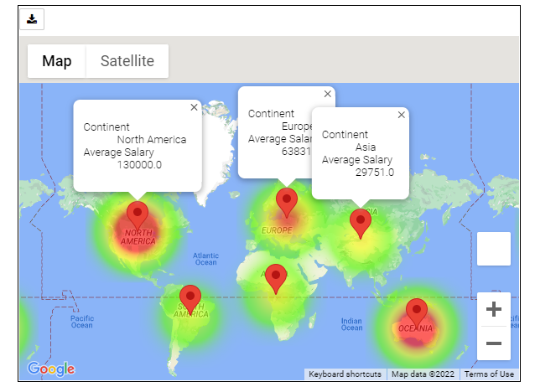

Slide 24
Research Question 3:
How do data science role salaries vary by role type? Out of all the Data Science Job Titles, which Job Title has the highest average salary?

Slide 25
How Many Job Titles In Data Science?
There are 50+ job titles in Data Science.
A lot of job titles are very unpopular.
Which one is the popular job title? Our research will focus on popular job titles.

Slide 26
Which One Is The Popular Job Title?
We will draw a pie chart to present the popular. The pie chart is easy to read and understand.
But there are many job titles, so we classified the unpopular job titles in a new group called ‘Other’.
According to the data, we chose top 14 job titles which has more than 1%.

Slide 27
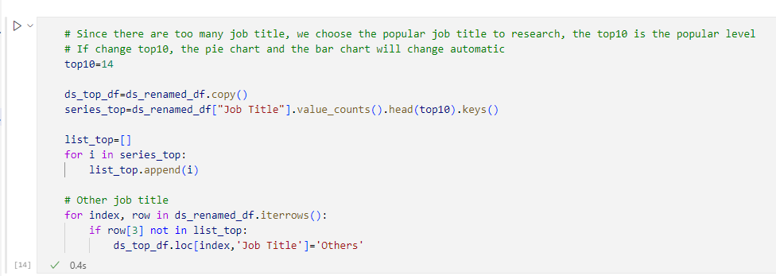
Classify The Unpopular Jobs’ Title As ‘Other’

Slide 28
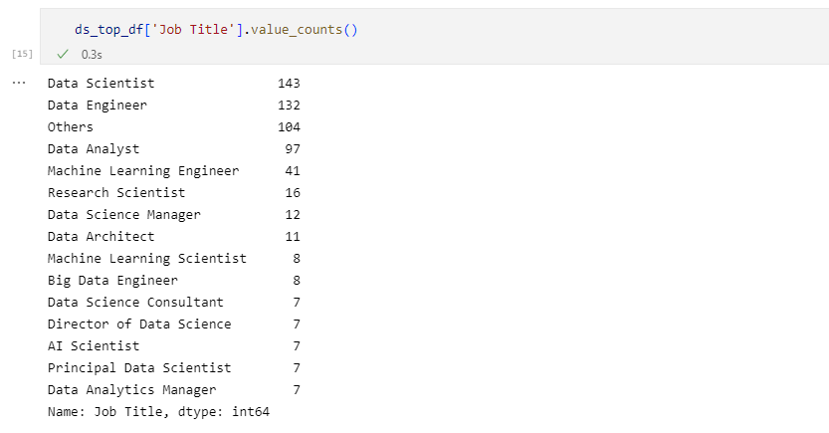
Result

Slide 29
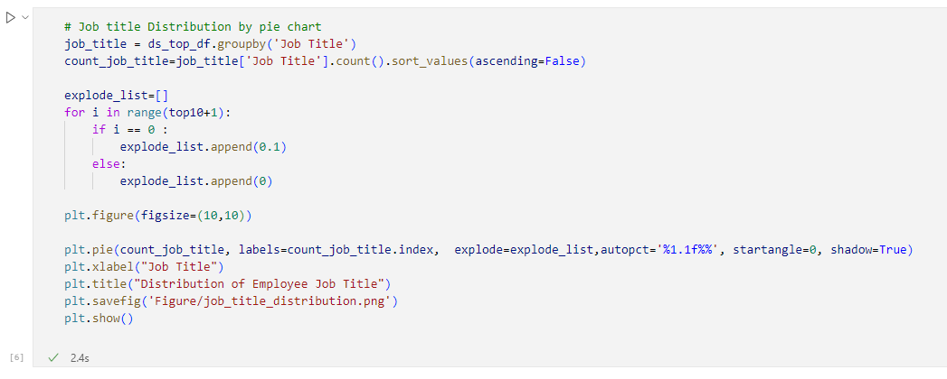
The Popular Job Title, Draw A Pie Chart

Slide 30
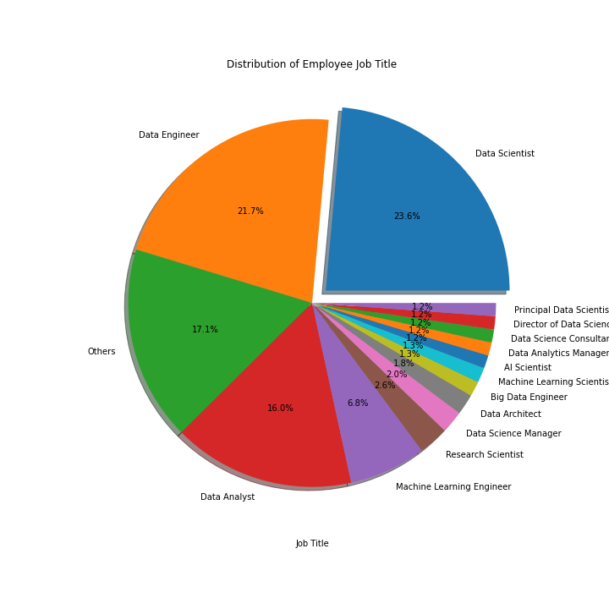
The Pie Chart of Popular Job Title

Slide 31
Major Findings 1
The most popular job title is 'Data Scientist, 23.6%, the second one is 'Data Engineer', 21.7%, the third one is 'Data Analyst', 16%.
The top three accounted for 61.3%.
The other for 17.1%, so the top 14 accounted for 82.9%.

Slide 32
Which Job Title Has The Highest Average Salary?
The high average salary will be research in popular job title. The rare one has few samples, make a average mean nothing.

Slide 33
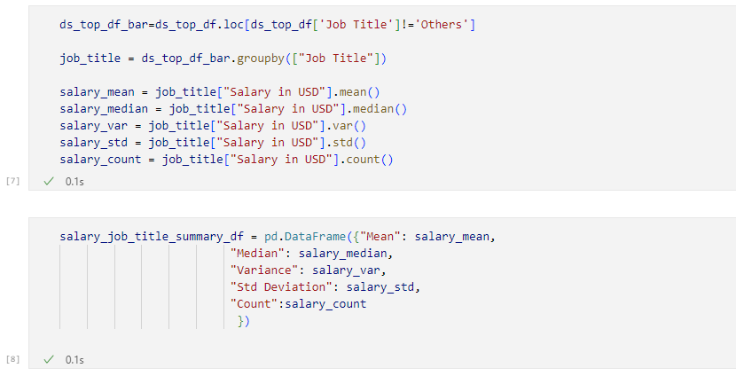
Group By Job Title, And Get Mean/Average

Slide 34
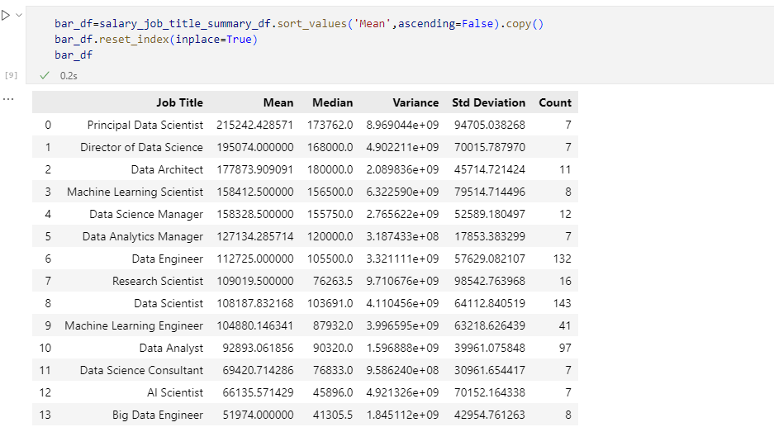
Prepare Data To Draw Bar chart

Slide 35
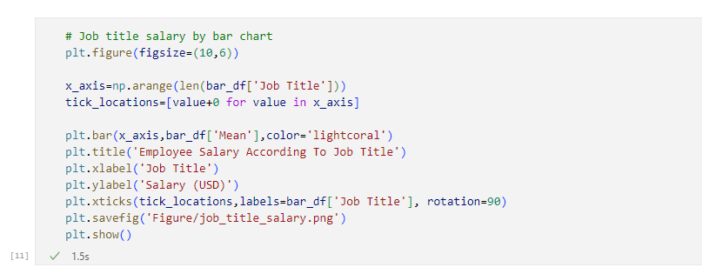
Draw A Bar Chart

Slide 36
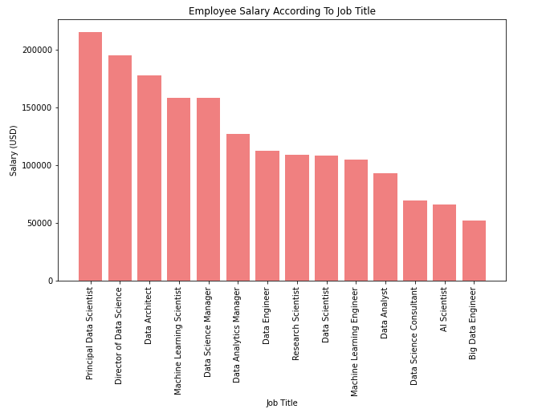
Employee Average Salary According To Job Title

Slide 37
Major Findings 2
The highest salary of job title is 'Principal Data Scientist’, the next one is 'Director of Data Science'.
Except for management position, the highest one is 'Data Architect’.
The 'Big Data Engineer' is not good for employee, this job title average salary is USD 52000, only half of 'Data Engineer'. 'Big' is less.

Slide 38
Resources:
--> Jupytor Python Notebook or Visual Studio Code. (Develop Code)
-->Google API Key (https://console.developers.google.com/getting-started) as 'g_key’
-->Create API Keys and store it in the 'api_keys.py' file before running the Jupyter notebooks.
Search | Kaggle Data Science salaries ( ds_salaries.csv)

Slide 39
The End
Thanks for watching.

